Slide 1

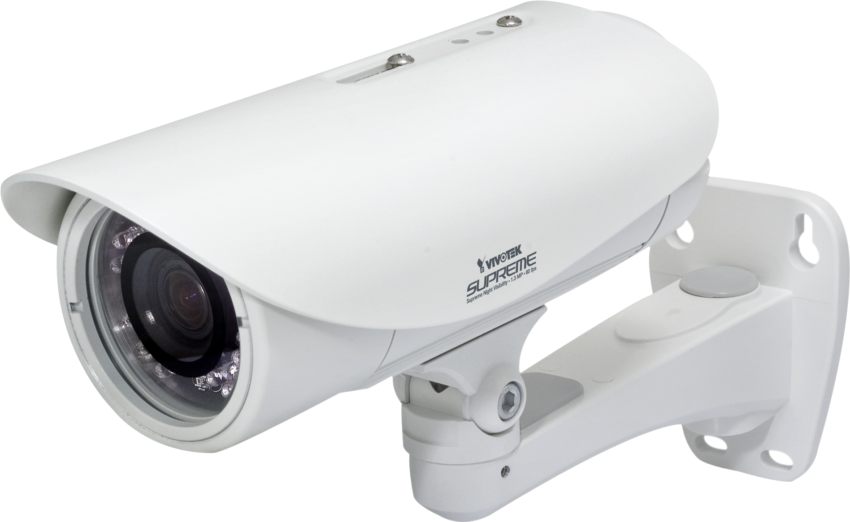

A Literature Review
Intelligent CCTV Surveillance Systems
Advancements, Applications, and Ethical Concerns
Project Members:
Priyank Sutaria - 60004220164 Sujal Moradiya- 60004220165
Mihir Desai- 60004220047
Sneh Dholia-60004220044
Project Guide:
Prof. Pranit Bari

Slide 2


Table of Contents
1
Introduction
6
Feasibility and Viability
2
Monitoring of Student Behavior
7
Results of our model
3
Solutions for Student Behavior Monitoring
8
Future Scope: Intelligent Surveillance in Corporate Environments
Results and Accuracy of Models
4
9
References
5
10
Conclusion
Architecture

Slide 3

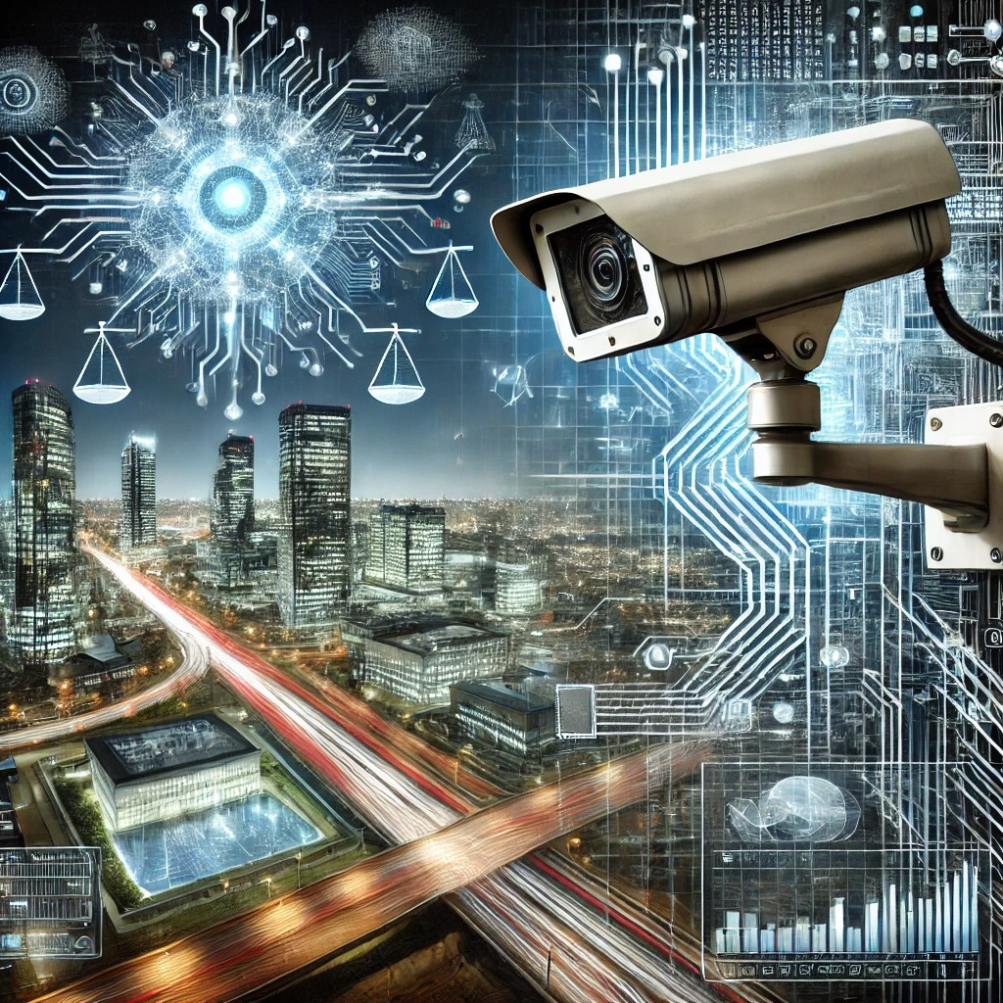
Introduction
Intelligent CCTV systems leverage AI and machine learning to improve surveillance, enabling real-time video analysis and anomaly detection. These systems automate security processes, enhancing monitoring beyond the limitations of human operators. This literature review explores the evolution, features, and ethical implications of these systems, specifically focusing on applications in corporate and educational environments.
Photo by Pexels

Slide 4

Problem Statement: Monitoring of Student Behavior in Educational Environments
Educational institutions face significant challenges in effectively monitoring and managing classroom behavior due to the limitations of traditional surveillance systems. Current solutions rely on passive video recording and manual observation, which lack real-time analytical capabilities. This results in missed opportunities for timely interventions, limited support for classroom management, and an absence of actionable long-term behavioral insights. The inability to detect disengagement, anomalies, or unauthorized activities in real-time hampers both student engagement and overall academic performance .
To address these gaps, there is a pressing need for an AI-powered smart CCTV surveillance system that can provide automated, real-time analysis of student behavior. Such a system would enable immediate alerts for off-task activities, facilitate data-driven decision-making for classroom management, and offer long-term behavioral tracking to support personalized academic interventions and discipline management.
Photo by Pexels

Slide 5
Solutions for Student Behavior Monitoring
1. Real-Time Anomaly Detection:
Automatically flags unauthorized behaviors like phone use, chatting, or leaving the classroom. AI models such as Support Vector Machines (SVM) continuously analyze video streams to detect off-task actions.
Example: Detects when students are distracted or not paying attention during lessons.
2. Behavior Monitoring and Analysis:
AI systems analyze student engagement, participation, and distractions using advanced algorithms like CNNs and YOLO.
Example: Notifies teachers when a student is frequently disengaged or distracted, allowing immediate intervention.
3. Monthly Behavioral Reports:
The system generates detailed reports summarizing student behavior patterns over time, enabling data-driven decisions on student performance and discipline.
Example: Monthly summaries provide insights into student participation trends, helping educators adjust strategies.

Slide 6
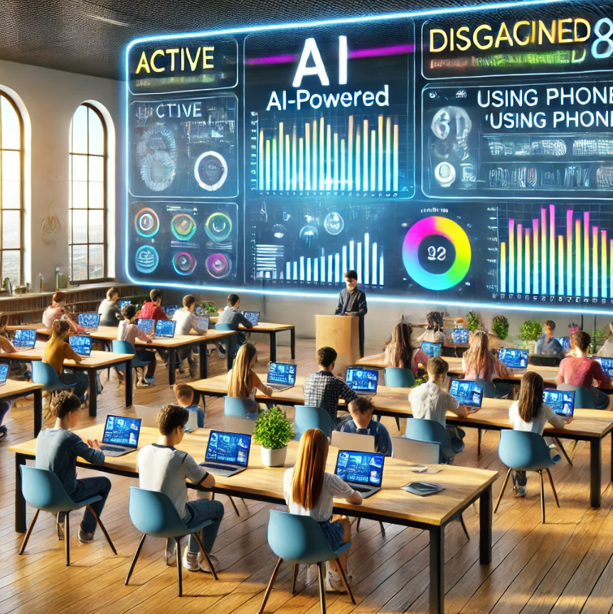
Solutions for Student Behavior Monitoring
4. Enhanced Classroom Management:
By identifying patterns of disengagement or off-task behavior, AI helps teachers tailor their instruction to re-engage students or address issues.
Example: Alerts teachers when students frequently disengage, allowing for real-time classroom adjustments.
5. Integration with School Policies:
AI data can be integrated with student records to align behavioral interventions with school policies, ensuring consistency in discipline and support.
Example: Uses behavior data for evidence-based disciplinary actions, ensuring they are aligned with school regulations.

Slide 7


Results and Accuracy of Models
Convolutional Neural Networks (CNNs):
Use: Facial recognition, behavior monitoring.
Accuracy: Achieves 95% accuracy in identifying individuals in real-time, even in low-light environments.
Application: Corporate settings, educational institutions.
YOLO (You Only Look Once):
Use: Real-time object detection
Accuracy: Detects objects (humans, vehicles) with 92% accuracy, reducing false alarms and improving threat detection speed.
Application: Smart cities, traffic monitoring.
Photo by Pexels

Slide 8
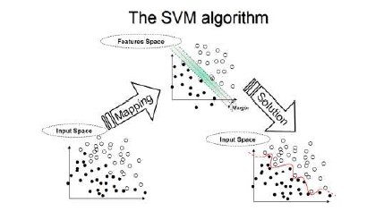
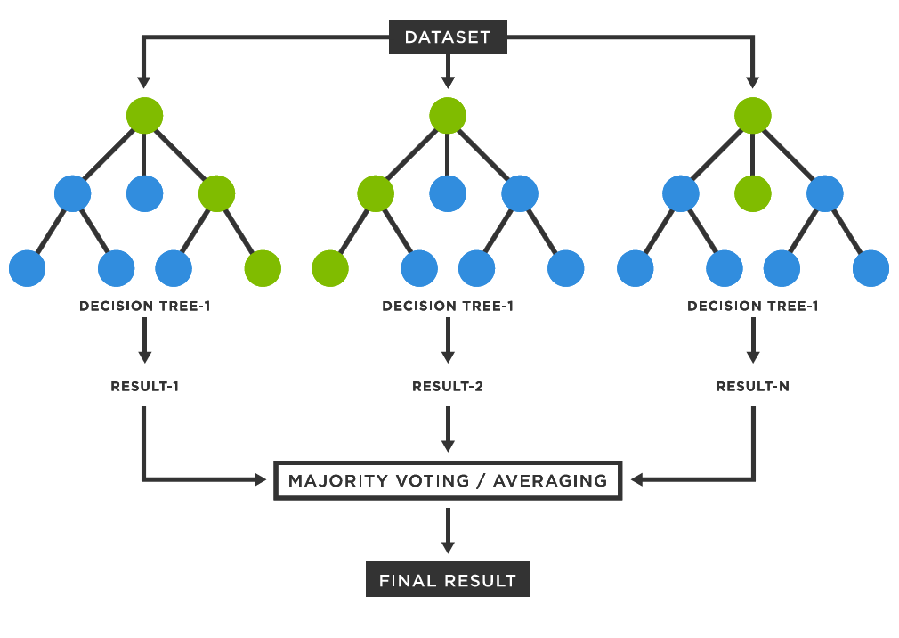
Results and Accuracy of Models
3. Support Vector Machines (SVM):
Use: Anomaly detection in behavior
Accuracy: Identifies behavioral anomalies with 90% accuracy, making it highly effective in monitoring off-task behaviors in educational settings.
4. Random Forest and Neural Networks:
Use: Predictive maintenance and crime forecasting
Accuracy: Predict equipment failures and potential security breaches with up to 90% accuracy.
Application: Manufacturing, corporate security systems.
Photo by Pexels

Slide 9
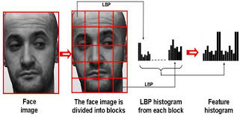
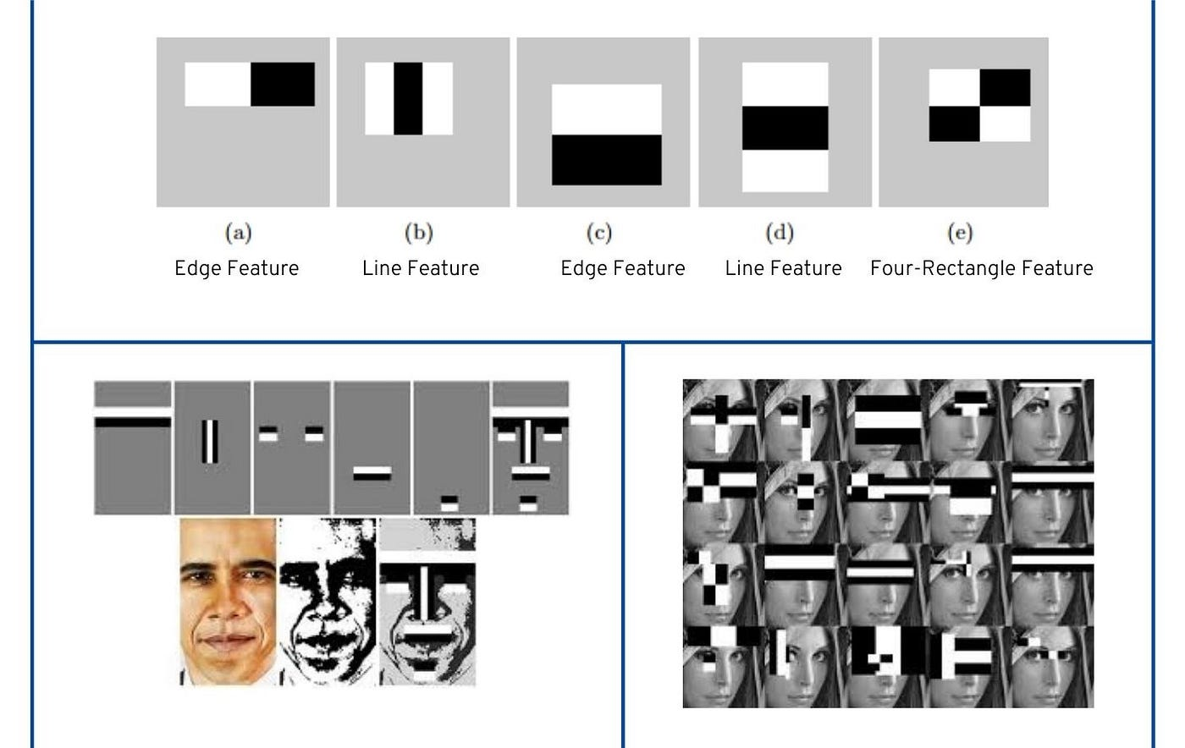
Results and Accuracy of Models
5. Local Binary Patterns Histograms (LBPH):
Use: Face recognition for attendance tracking.
Accuracy: Effective, especially in integration with CNNs.
Application: Educational settings, biometric surveillance.
6. Haar Cascades:
Use: Face detection and recognition.
Accuracy: Lower than CNNs and LBPH but efficient for simple object detection tasks.
Application: Basic face detection in security systems.
Photo by Pexels

Slide 10
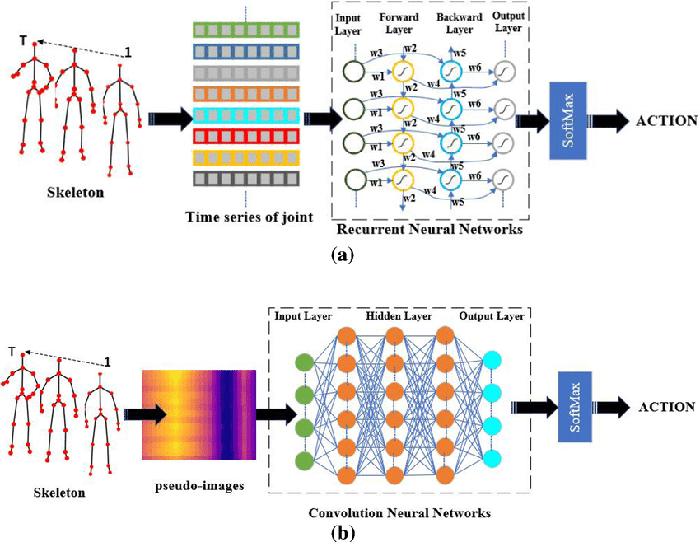
Results and Accuracy of Models
7. Recurrent Neural Networks (RNNs):
Use: Behavior pattern recognition over time.
Accuracy: Suitable for sequential data analysis, effective in identifying behavior trends.
Application: Educational surveillance for real-time monitoring of student engagement.
Photo by Pexels

Slide 11
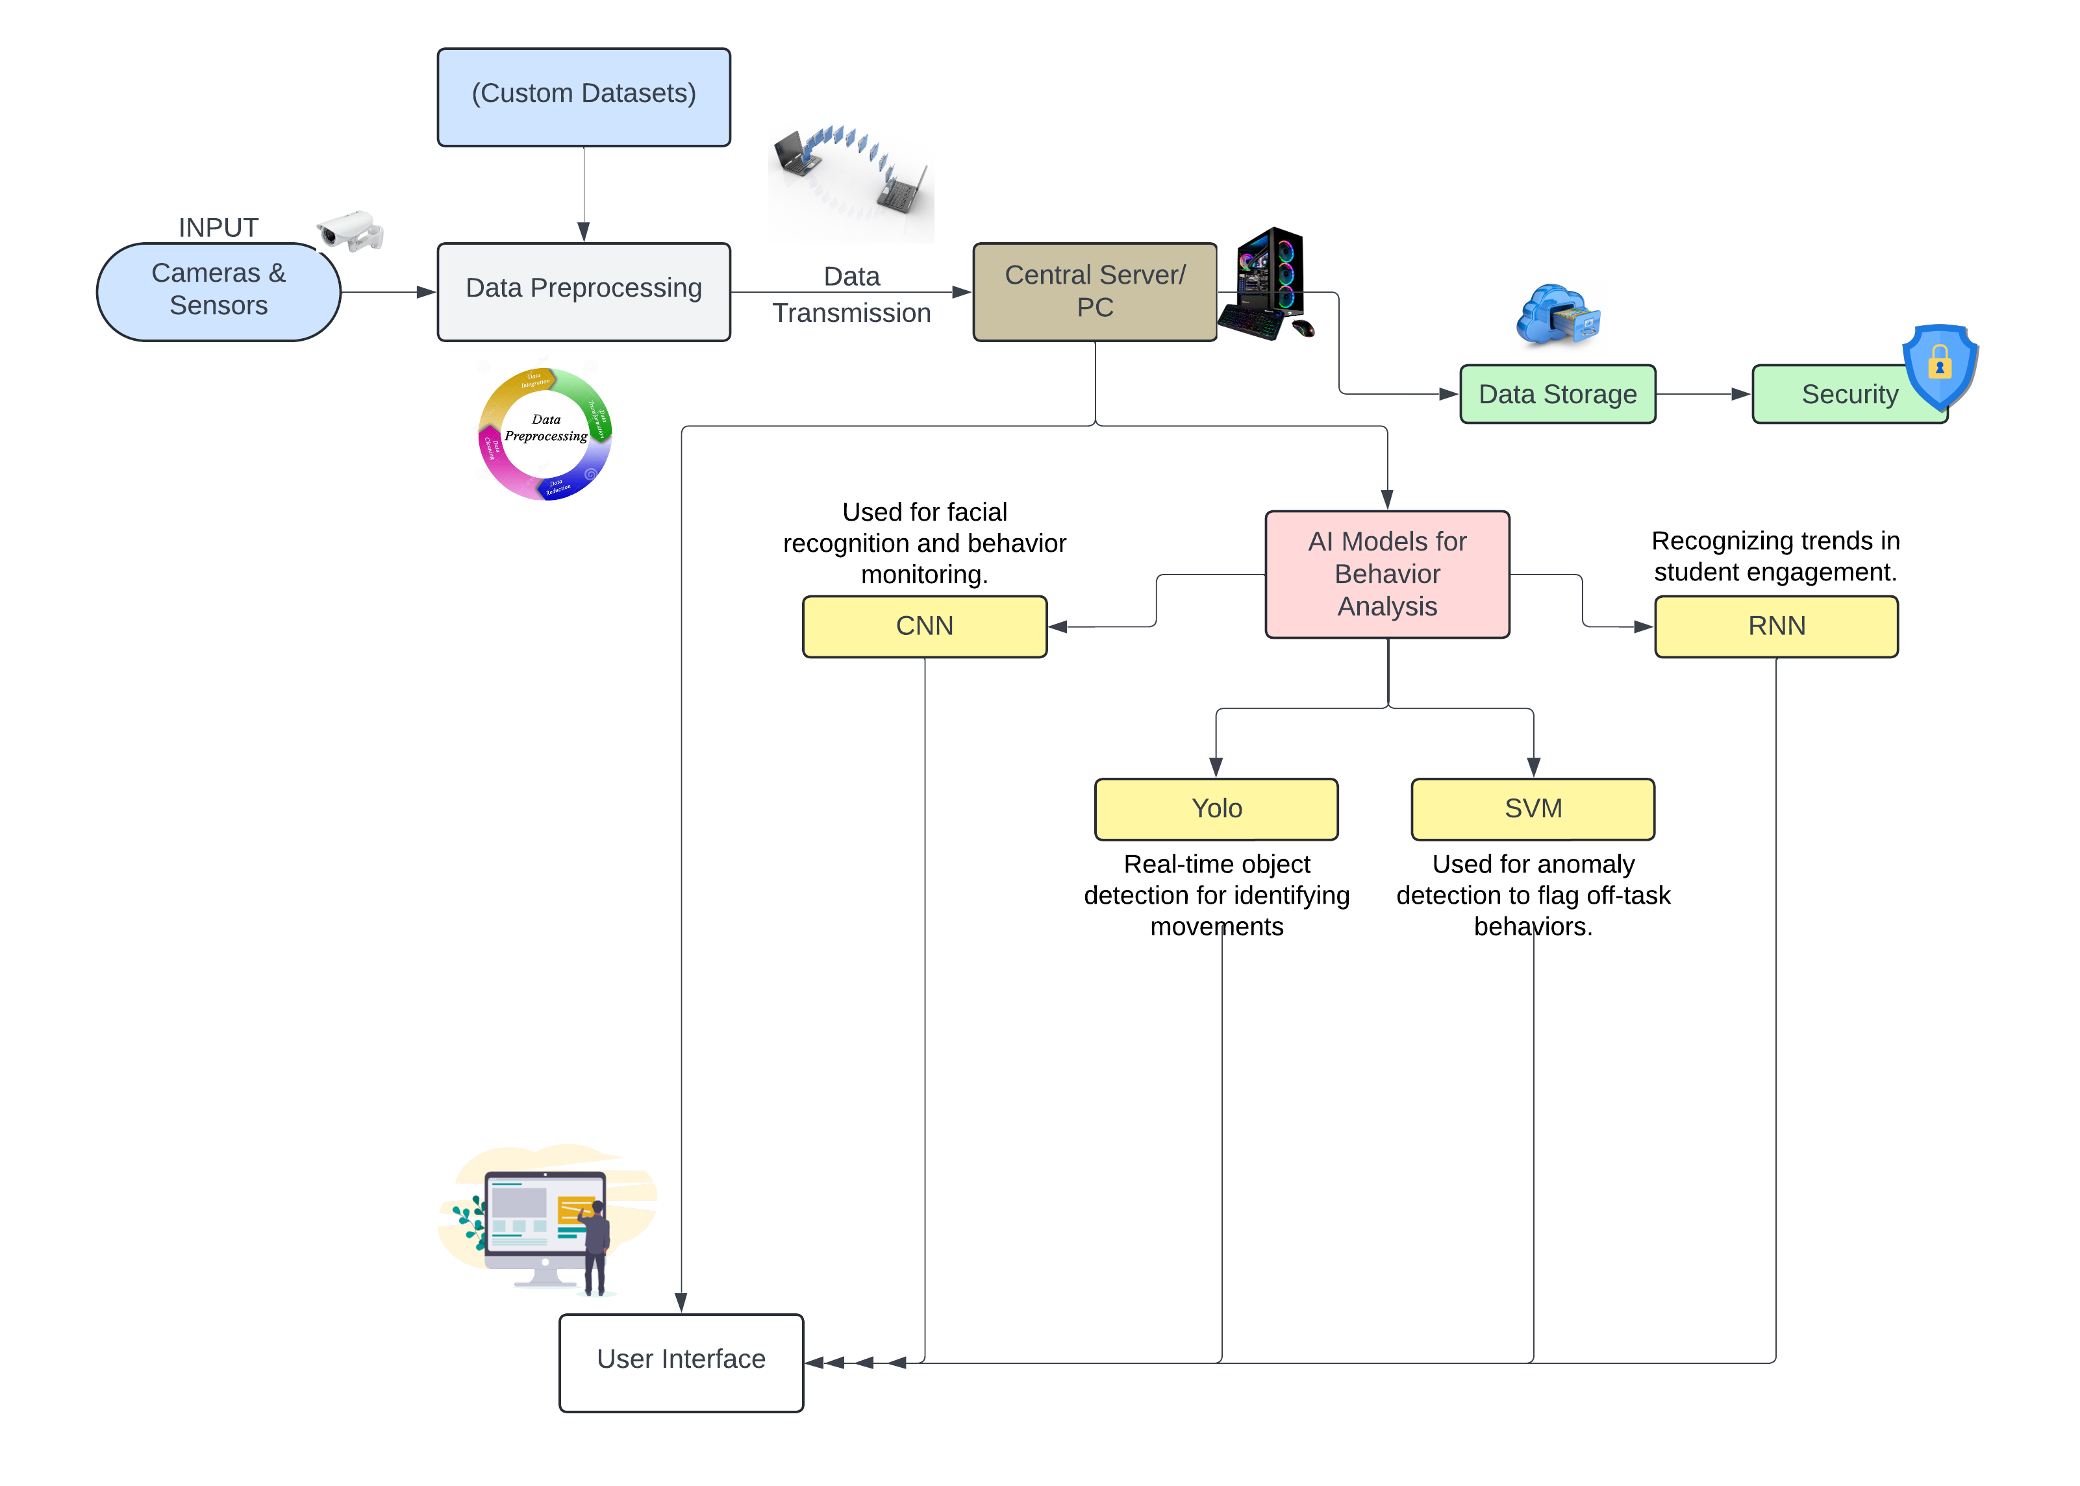
Architecture:
Photo by Pexels

Slide 12

Feasibility and Viability
Feasibility:
Technical Feasibility: AI models like CNNs are highly accurate for real-time monitoring and can be integrated with existing systems.
Operational Feasibility: Scalable with existing infrastructure; initial costs are high but offset by long-term efficiency gains.
Challenges and Risks:
Data Privacy: Facial recognition and behavior analysis raise privacy concerns; handling sensitive data requires strict compliance with regulations like GDPR.
Regulatory Compliance: Adhering to legal frameworks is essential to avoid ethical and legal issues.
Potential Bias: AI systems need careful testing to avoid bias and ensure fair monitoring.
Viability:
The system is viable for improving security and efficiency but depends on addressing privacy, regulatory, and ethical concerns.
Photo by Pexels

Slide 13
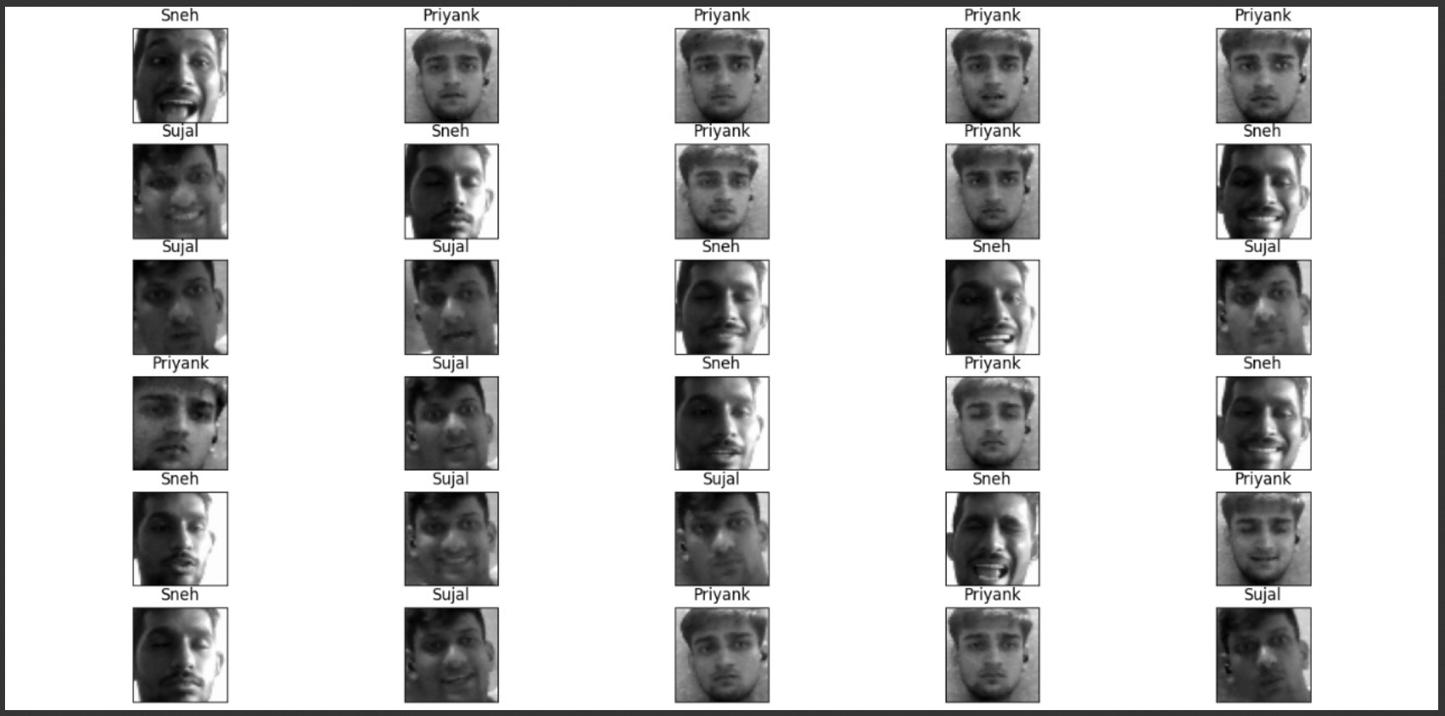
Results of our Model :
Haar Cascade model :
Face Recognition

Slide 14
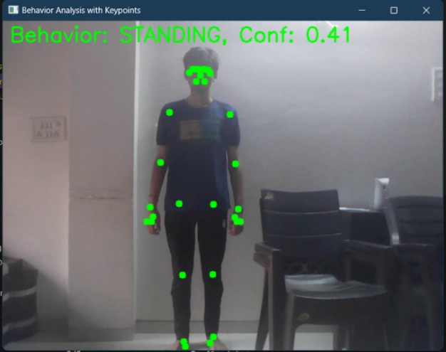
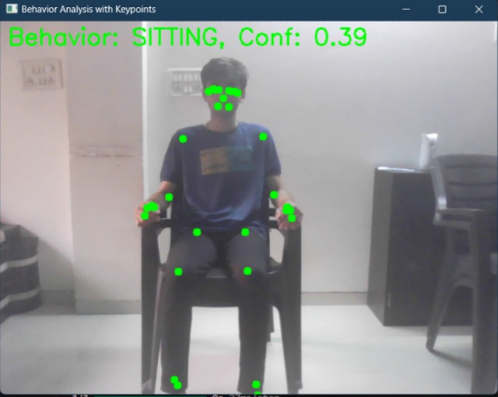
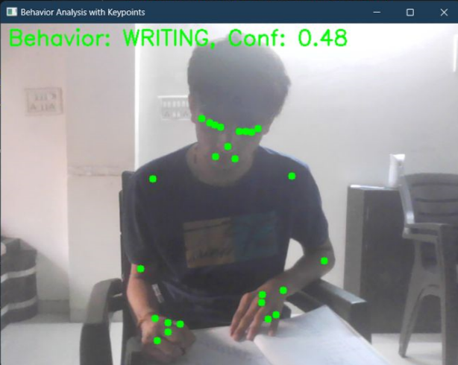
Results of our Model :
2. RNN-LSTM:
Standing position Sitting position Writing

Slide 15
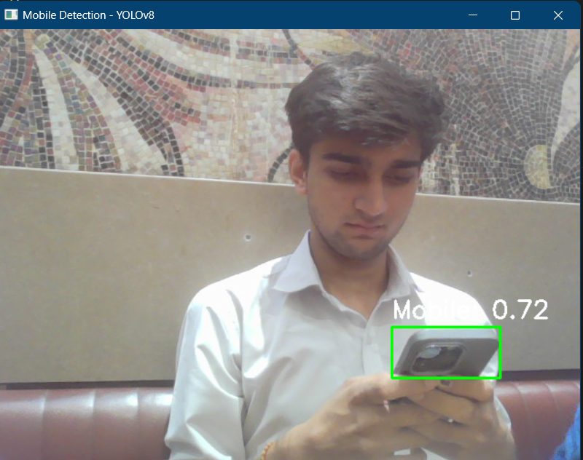
Results of our Model :
3. YOLOv8
Object detection

Slide 16

Future Scope: Intelligent Surveillance in Corporate Environments
Employee Productivity Monitoring:
AI can help track employee engagement, analyze workspace usage, and identify inefficiencies in real-time, leading to improved productivity.
Example: Automated detection of underutilized spaces or prolonged idle time can help optimize workflow.
Security and Access Control:
AI systems monitor for unauthorized access or suspicious activities, enhancing overall security.
Example: Real-time alerts for security breaches or restricted area violations, ensuring faster response times.
Photo by Pexels

Slide 17
References Research papers:
Arslan, Y., & Canbolat, H. (2022). Sound-based alarming video surveillance system design. Multimedia Tools and Applications, 81, 7969–7991.
Budiman, A., Fabian, Yaputera, R. A., Achmad, S., & Kurniawan, A. (2022). Student attendance with face recognition (LBPH or CNN): Systematic literature review. Retrieved from ResearchGate.
Hamm, L. M., Mistry, K., Black, J. M., Grant, C. C., & Dakin, S. C. (2019). Impact of children’s postural variation on viewing distance and estimated visual acuity. Translational Vision Science & Technology, 8(1), 16. https://doi.org/10.1167/tvst.8.1.16
Khandelwal, A., Narang, R., & Dubey, A. (2022). Employee performance monitoring using OpenCV and WMI. Retrieved from ResearchGate.
König, J., Santagata, R., Scheiner, T., Adleff, A.-K., Yang, X., & Kaiser, G. (2022). Teacher noticing: A systematic literature review of conceptualizations, research designs, and findings on learning to notice. Educational Research Review, 36, Article 100453. https://doi.org/10.1016/j.edurev.2022.100453
Wu, R. W., Yiu, T. W., & Jelodar, M. B. (2022). Real-time employee monitoring technologies in the construction sector – Effect readiness and theoretical perspectives: The case of New Zealand. IOP Conference Series: Earth and Environmental Science, 1101.
Wu, R. W., et al. (2021). Real-time employee monitoring system using CCTV cameras. ResearchGate.
Photo by Pexels

Slide 18
References
Links:
Git hub link:
https://github.com/stuarteiffert/RNN-for-Human-Activity-Recognition-using-2D-Pose-Input.
YouTube link:
https://youtu.be/pNf4-d6fDoY?si=kOJqfJgDJ6EgdAjz
Model Link:
1. https://youtube.com/playlist?list=PL18uP4AzeyVuqH7dRNmyLGR1USnSgfliV&si=YLOIlN4PCyGg42Kl
2. https://youtu.be/9jQGsUidKHs?si=ollZIibx3SMxSkVm

Slide 19

Thank You!
Thank you for engaging with this presentation on intelligent CCTV surveillance systems.
Your attention is valued as we explore the intersection of technology, security, and ethics.
Together, we can create safer environments that respect individual privacy.
Stay informed and proactive in the age of intelligent surveillance systems!
Photo by Pexels

